Slide 1

Chapter six
Synchronous Machines

Slide 2
Chapter six
Synchronous Machines
6.1 Basic Principle and Construction
6.2 Equivalent Circuit and Phase Diagram
6.3 Torque and Power in Terms of Load angle
Torque-angle curve
6.4 Circle Diagram and V-Curve
6.5 Starting Synchronous motors
6.6 Other Kinds of Machines

Slide 3
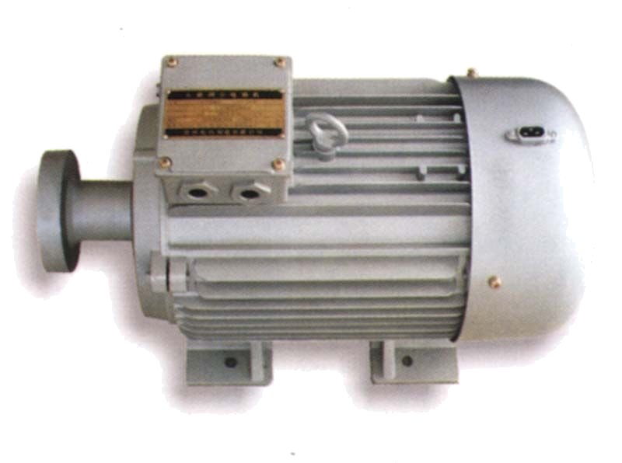
Introduction to poly-phase synchronous machine
A synchronous machine is one in which alternating current flows in the armature winding, and dc excitation is supplied to the field winding. The armature winding is almost invariably on the stator and is usually a three-phase winding. The field winding is on the rotor.

Slide 4
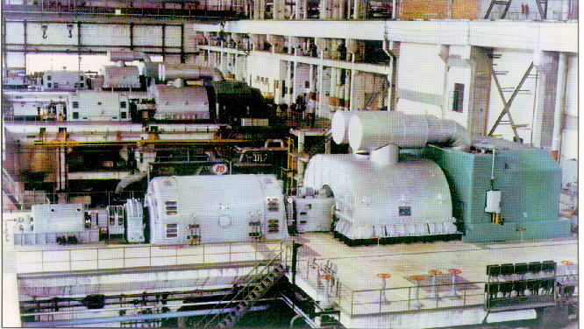
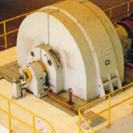
These are some pictures of synchronous machines :

Slide 5
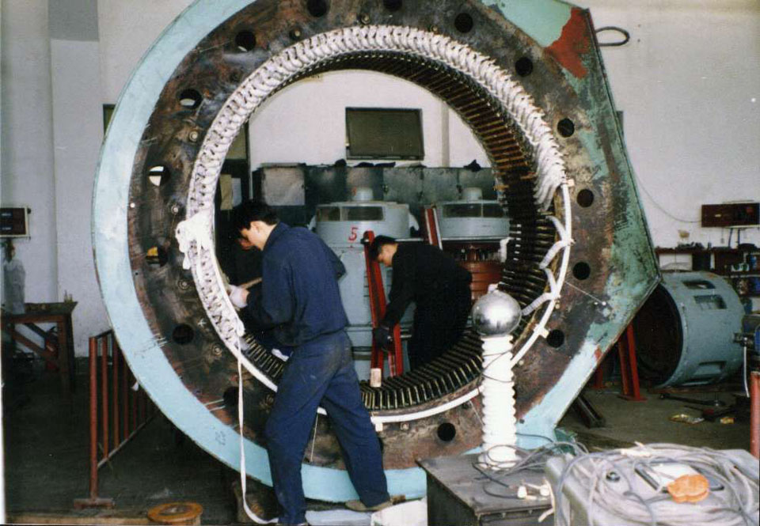
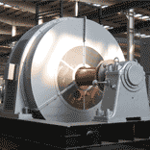
These are some pictures of synchronous machines :

Slide 6
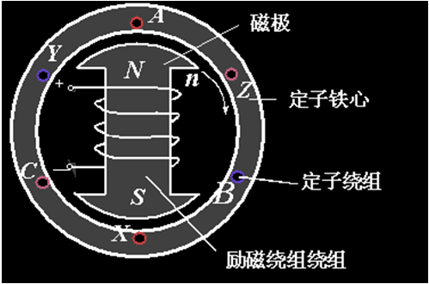
6.1 Basic Principle and Construction

Slide 7
6.1 Basic Principle and Construction
6.1.1 Synchronous operation
From chapter three, we know that the synchronous speed produced by three phase windings would be n1=60f/p.
A synchronous machine can only run at a speed
of n1=60f/p in the steady state.

Slide 8
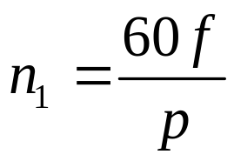
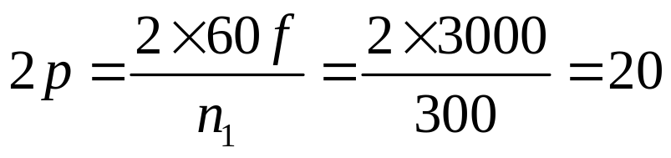
Example 6-1
6.1.1 Synchronous operation
A synchronous machine operates at 50Hz and runs at 300 r/min, calculate the number of salient poles in the rotor.
Solution:

Slide 9
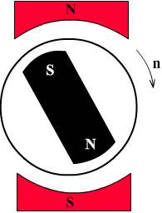

6.1.1 Synchronous operation
Assume a pair of N-S poles is used to represent the behavior of a rotating magnetic field mmf as shown in the Figure 6-1 .It is easy to see that for the machine to develop a uniform torque, the armature magnetic fields and the rotor dc field must be rotating at same speed, which means they are stationary with respect to one another. Therefore, there must be a physical movement of the rotor at synchronous speed .
Figure 6-1 Principle of
synchronous machine

Slide 10
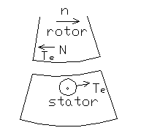
6.1 Basic Principle and Construction
6.1.2 Motoring and Generating Operation
For a motor, the rotor is droved by
another motor, as shown in Fig 6-2. The
direction of the induced e.m.f. and current
in rotor would be out of the paper and the
torque on the conductor would be
counterclockwise; see also Fig6-2.
For a generator, the stator is forced left and the rotor is moved by the reverse force .
Figure 6-2 Motoring and generating

Slide 11








6.1.2 Motoring and Generating Operation
See a generating process shown below:
U1
W2
V2
V1
W1
U2
Generating process

Slide 12
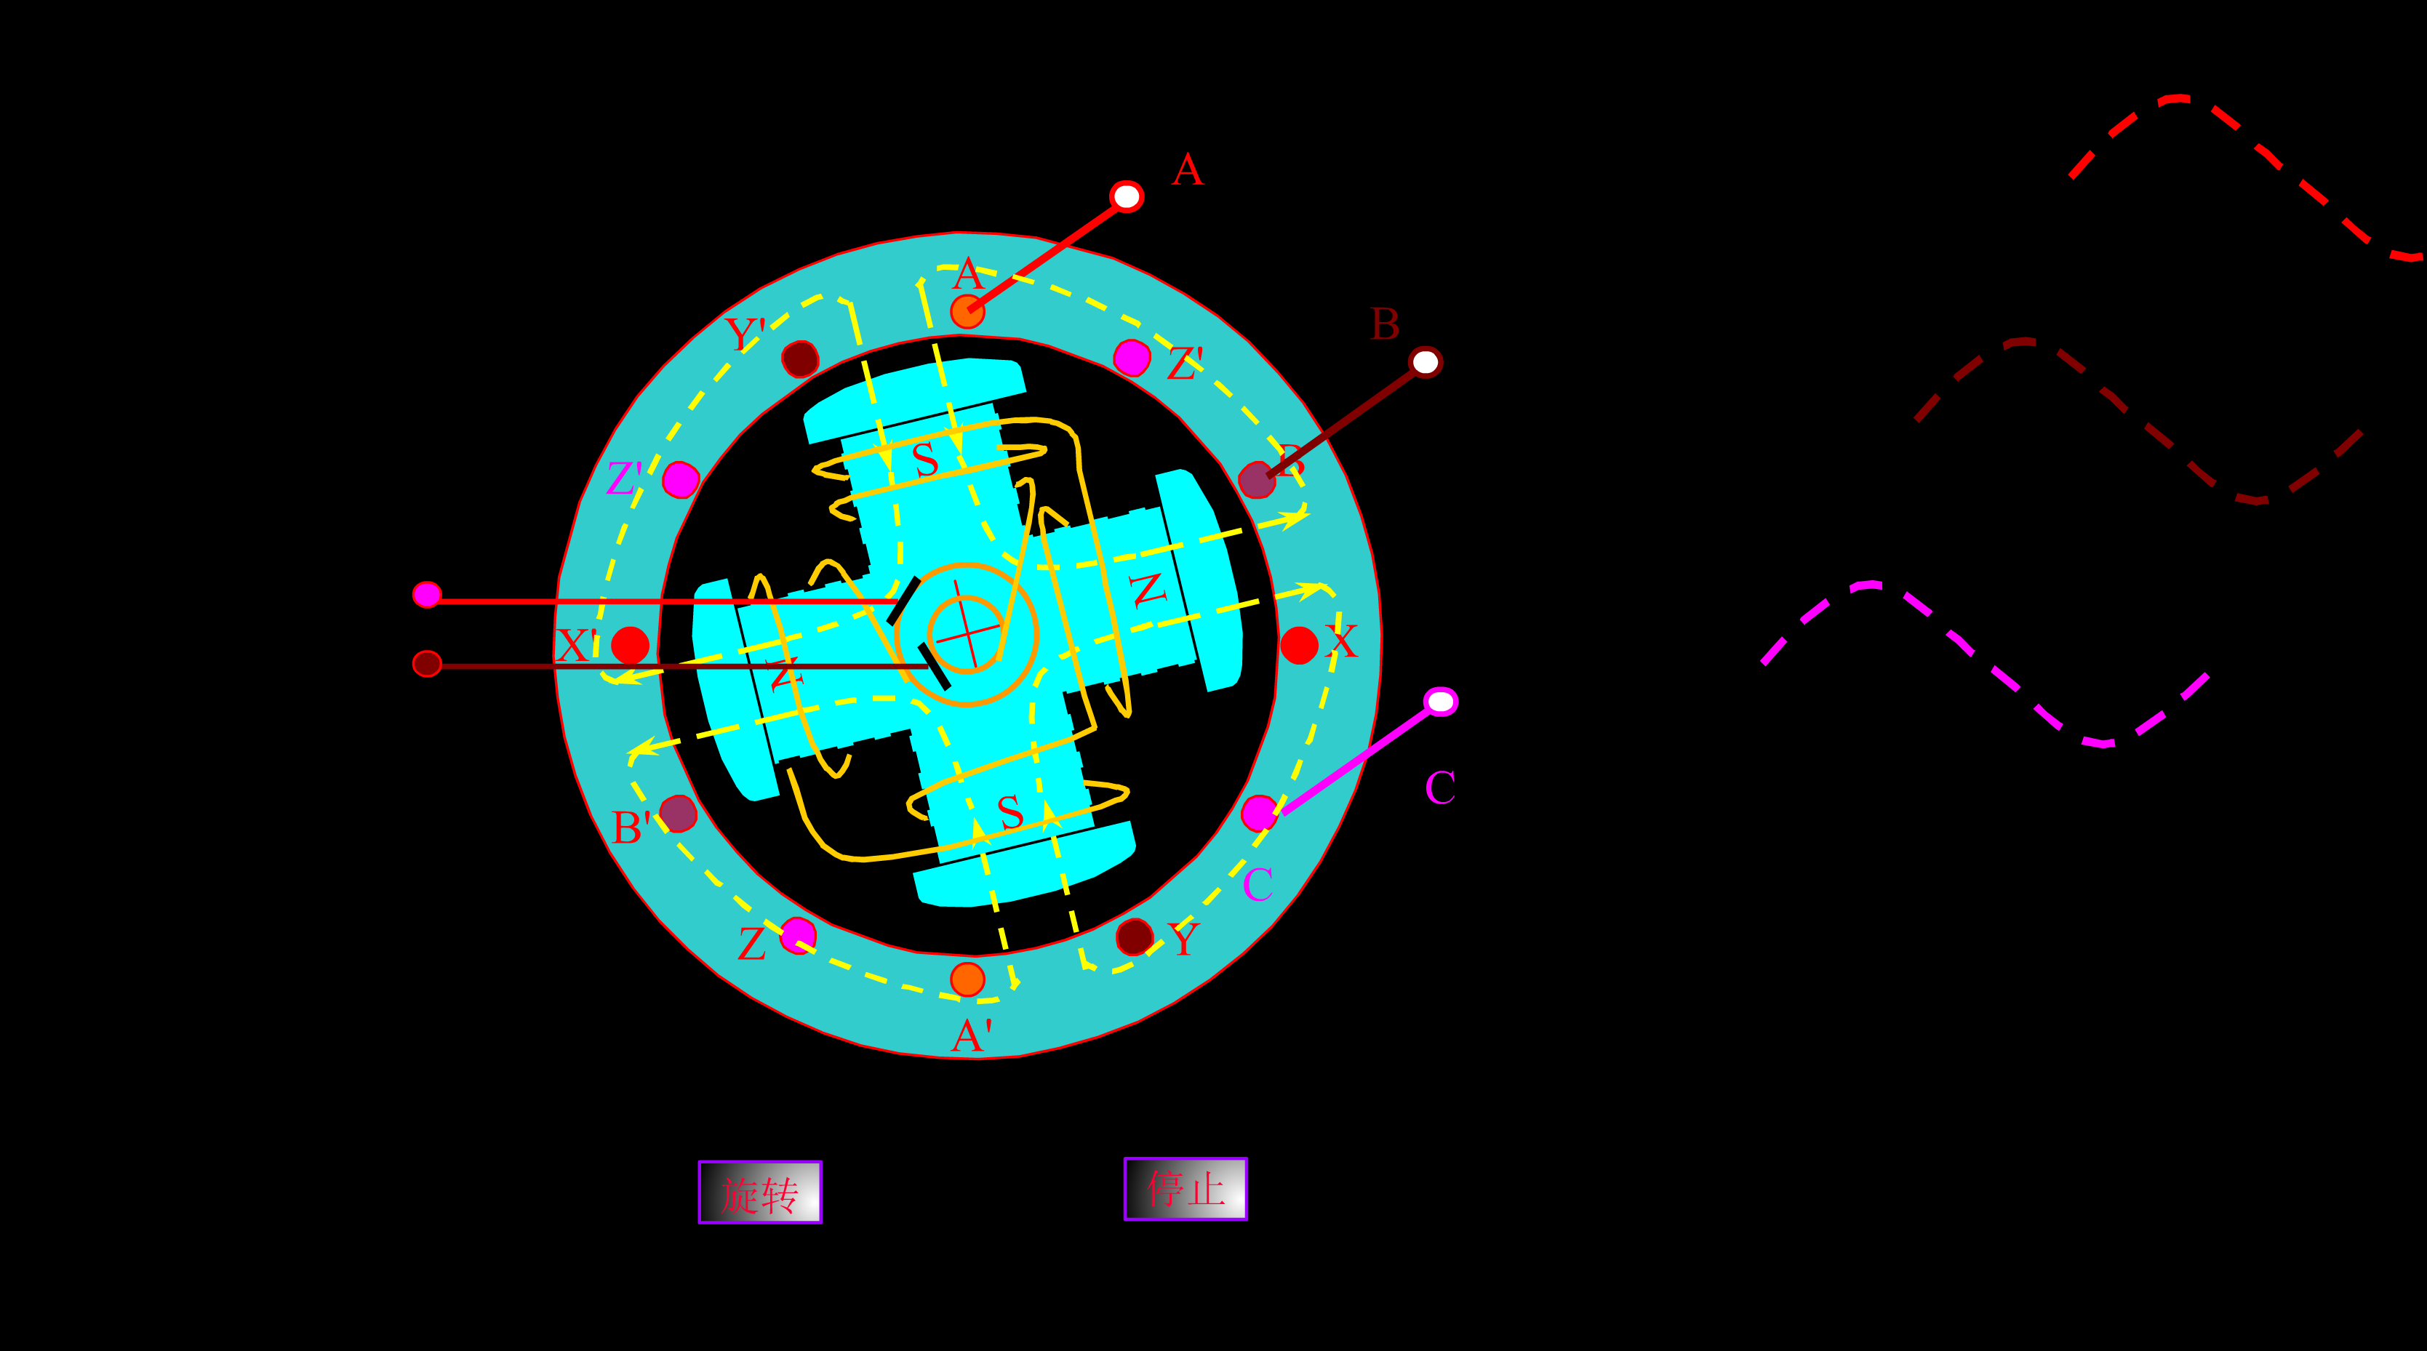
6.1.2 Motoring and Generating Operation
See the flash show a generating process :

Slide 13
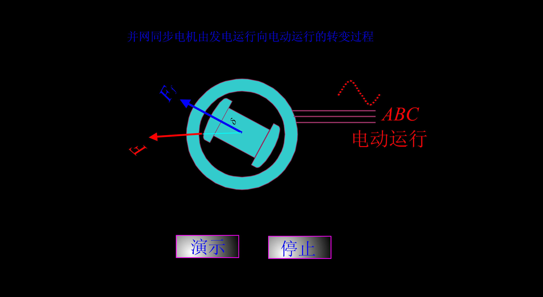
6.1.2 Motoring and Generating
See the flash shown below that a synchronous machine operate from generating to motoring.

Slide 14
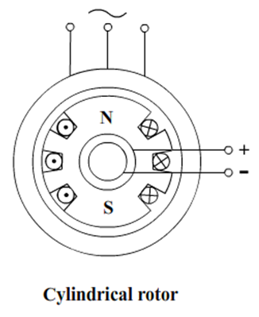
6.1 Basic Principle and Construction
6.1.3 Cylindrical Rotor Construction
In Cylindrical Rotor, the air gap is uniform, and the rotor mmf may be taken to be distributed sinusoidal in space.
Such a rotor has a suitable distributed and chorded 3-phase winding and is excited with a direct current, usually with one phase carrying the full value, and the other two, half negative value each.

Slide 15
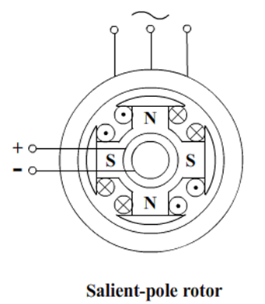
6.1 Basic Principle and Construction
6.1.4 Salient-Pole Rotor Construction
The lower-speed synchronous machine, hydro electric generators(水电发电机) for example, utilize salient-pole rotors.
In general use,4-pole construction is quite common, but 2-pole construction is only used in very small machines.
Salient poles leave a large spare for field windings, but in general give a flux wave with pronounced lower-order harmonics.

Slide 16
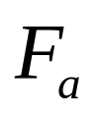

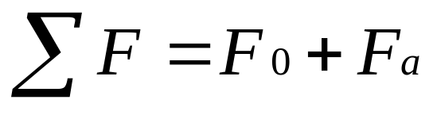


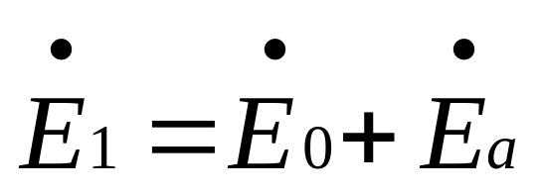

6.2 Equivalent Circuit and Phase Diagram
6.2.1 Cylindrical Rotor
: the mmf produced by stator winding
: the dc mmf produced by rotor winding
The induced voltages in the armature winding will be and accordingly. Correspondingly we have:
where the resultant voltage is the emf produced by ∑F.

Slide 17
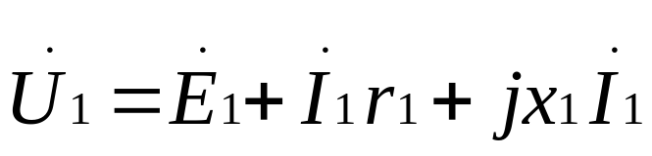
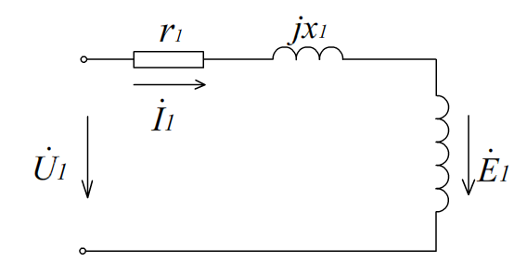
6.2.1 Cylindrical Rotor
According to the previous sections, the stator voltage equation can be written as:
Where: r1 – stator resistance
x1 – stator leakage inductance
Equivalent circuit

Slide 18
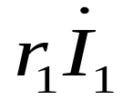
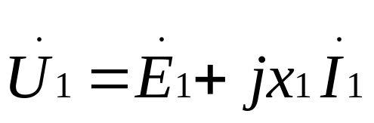
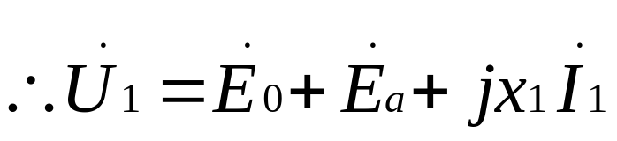
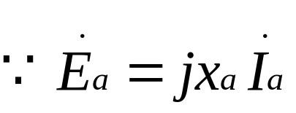
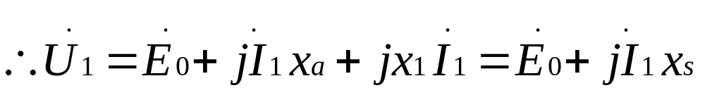

6.2.1 Cylindrical Rotor
If is omitted for the purpose of simple analysis, the voltage equation is written as:
------synchronous reactance(同步电抗)

Slide 19
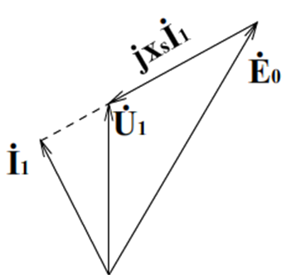
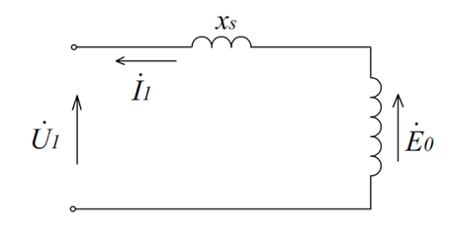
6.2.1 Cylindrical Rotor
The phase diagram and equivalent circuit can be drawn below.
equivalent circuit `
phasor diagram

Slide 20



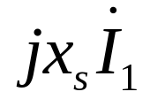
6.2.1 Cylindrical Rotor
Example 6-2
A 500kw, 600r/min synchronous motor connected to a 3980V, 3-phase line generator. An excitation voltage is1790V(line to neutral) when the dc exciting current is 25A. The synchronous reactance is 22Ωand the torque angle between and is .
Calculate:
The value of .
The value of the ac line current.
The power factor of the motor.
The approximate power developed by the motor.
The approximate torque developed at the shaft.

Slide 21
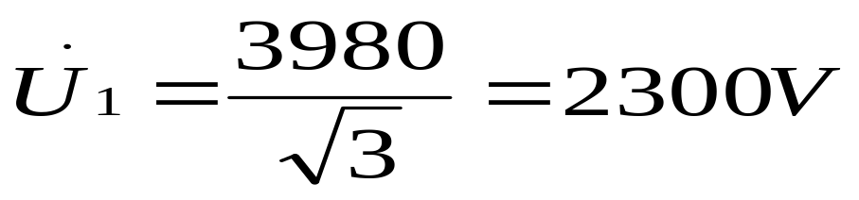
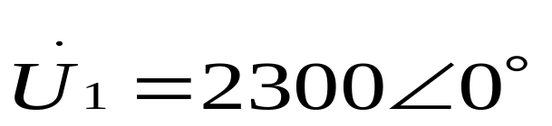
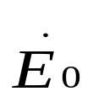
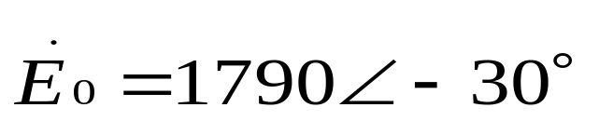
6.2.1 Cylindrical Rotor
Solution:
a. The line-to-neutral voltage applied to the motor has a value
Let us select as the reference phasor, whose angle with respect to the horizontal axis is assumed to be zero. Thus,
It follows that is given by the phasor.

Slide 22
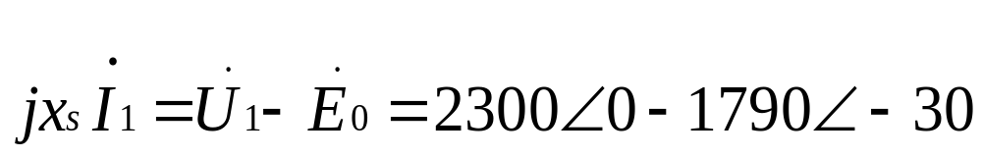

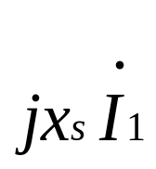
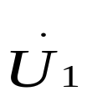
6.2.1 Cylindrical Rotor
The equivalent circuit per phase is given below.
We can get:
Thus, phasor has a value of 1168V and it leads phasor
by 50.

Slide 23
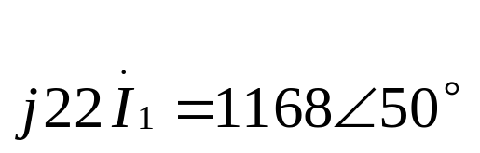
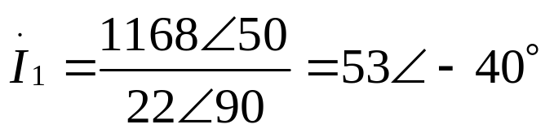
6.2.1 Cylindrical Rotor
b. The line current I is given by
Thus, phasor I_1 has a value of 53A and it lags 40°behind phasor .
c. The power factor of the motor is given by the cosine of the angle between the line-to-neutral voltage across the motor terminals and current I. Hence,
Power factor = cos40°= 0.766, or76.6%
The power factor is lagging because the current lags behind the voltage.

Slide 24
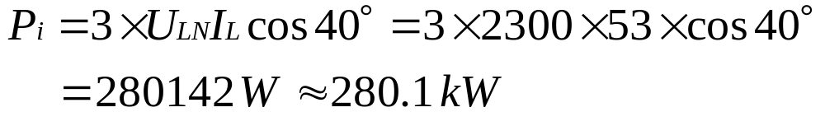

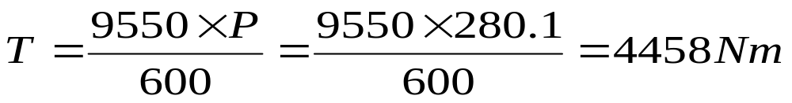
6.2.1 Cylindrical Rotor
d. Total active power input to the stator.
Neglecting the and iron losses in the stator, the electrical power transmitted across the air-gap to the rotor is 280.1KW
Approximate torque:

Slide 25
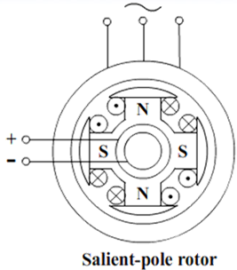
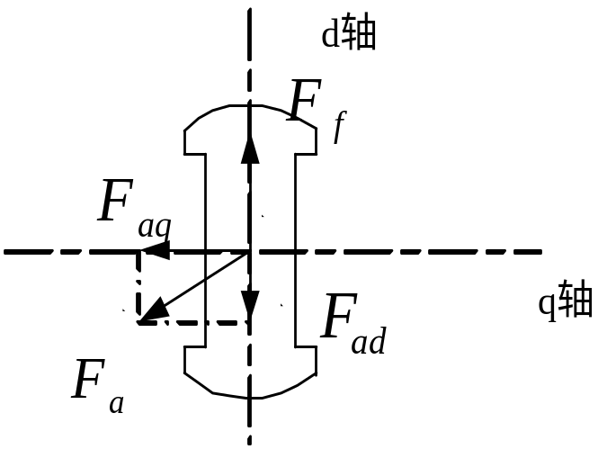
6.2 Equivalent Circuit and Phase Diagram
6.2.2 Salient rotor construction
For a salient rotor, the reactance varies with the rotor position. In order to analysis this more complicated machine, the d-q axis dual reaction principle is often used as stated below.

Slide 26
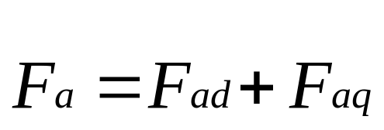

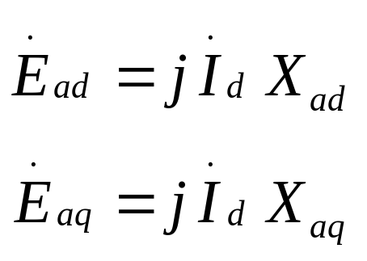
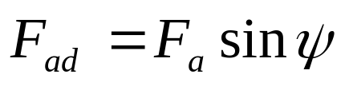
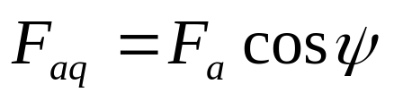
6.2.2 Salient rotor construction
When Fa in line with F0, the reactance is assumed as xad. When Fa is vertical to F0,the reactance facing by Fa is represented by xaq, therefore:

Slide 27
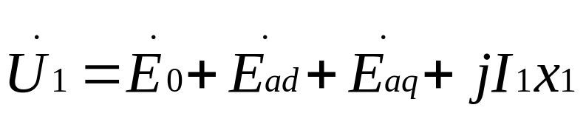
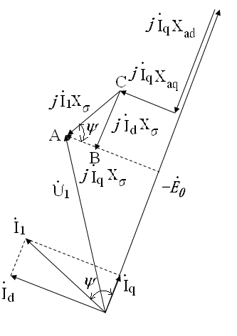
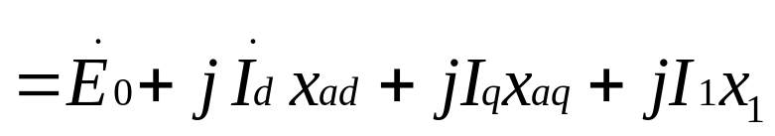
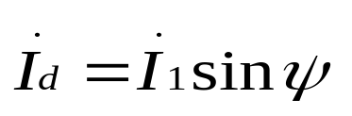
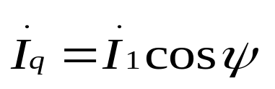



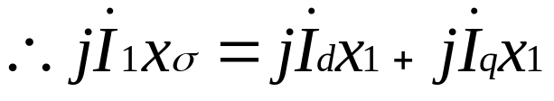
6.2.2 Salient rotor construction
for △ABC:

Slide 28









6.2.2 Salient rotor construction
So we have
Where
For cylindrical rotor machine, xd=xq=xs, so
--Power factor angle
Ψ --Inner power factor angle
--Torque angle

Slide 29



6.3 Torque and Power in Terms of Load
and Torque Angle Curve
6.3.1 Power balance and Torque balance

Slide 30





6.3.1 Power balance and Torque balance
Divided by synchronous angular speed, becomes torque
equation.
Where electro-magnetic torque.
No-load torque
Output torque

Slide 31



6.3 Torque and Power in Terms of Load
angle Torque-angle curve
6.3.2 Torque-angle Curve
Normally, capacity of synchronous machine is large and the efficiency is high. So assume
where: and are phase voltage and current.

Slide 32



6.3.2 Torque-angle Curve
From phasor diagram of salient rotor SM
so

Slide 33




6.3.2 Torque-angle Curve
so
assume

Slide 34



6.3.2 Torque-angle Curve
If it is cylindrical rotor motor, the reactance will be , and the torque becomes:
torque-angle curve

Slide 35






6.3 Torque and Power in Terms of Load
angle Torque-angle curve
6.3.3 The Physical Meaning of the Torque Angle
Torque angle is the angle between and . When stator impedance drop is neglected, the is corresponding to the angle between and . Then between the and .
When energizing current If is increased, the voltage will be increased as well. From the equation (6-19) we know that when increases, the torque T will be increased.

Slide 36

6.3.3 The Physical Meaning of the Torque Angle
torque – angle curve

Slide 37





6.3 Torque and Power in Terms of Load
angle Torque-angle curve
6.3.4 Steady State Operation
From the equation , the overloading ability can be got :
Normally, = 2-3, so it can be calculated as
Stable operation

Slide 38


6.4 Circle Diagram and V-Curve
The component in stator winding will be determined by the value of the excitation current in rotor winding, which will be explained in the circle diagram, when the load varies.
A synchronous motor must produce the equivalent
torque to balance its mechanical load to keep running,
therefore the developed torque is depend on the load.

Slide 39










6.4 Circle Diagram and V-Curve
6.4.1 Circle Diagram
Circle diagram
Different excitation for same load

Slide 40







6.4.1 Circle Diagram
When is kept at constant, and the load is varying, then from the equation (6-4), it can be got that;
Where is a constant on the condition of stator voltage unchanged. And
If the is kept unchanged, is a constant, then when the load is varying, the output power will change with the load and the active component of the current will change to meet the requirement of the load.

Slide 41



6.4.1 Circle Diagram
From the Figure shown below, we can see that when is constant, the dashed line is the trace of and its active component is the project to the phasor .
Circle diagram

Slide 42

6.4 Circle Diagram and V-Curve
6.4.2 V-Curve Load Constant
When load is constant, the active component of the stator current is constant as well, then the stator current trace with the excitation current varying will be like the dotted line in the Figure shown below.
Different excitation for same load

Slide 43

6.4.2 V-Curve Load Constant
The broken line locus in the Figure above corresponds to the minimum armature current at various loads; i.e. excitation adjusted to give unity power factor.
V – curve of a synchronous machine

Slide 44


6.5 Starting Synchronous motors
Three basic approaches can be used to safely start a synchronous motor:
1.Motor starting by using amortisseur windings
Amortisseur windings

Slide 45
6.5 Starting Synchronous motors
2.Motor Starting by Reducing Electrical Frequency
3. Motor Starting with an External Prime Mover

Slide 46

6.6 Other Kinds of Machines
6.6.1 Permanent Magnet machine

Slide 47


6.6.1 Permanent Magnet machine
The rotor of a permanent magnet machine, with some permanent magnet arrangement on, can be salient, like in the Figure (a), and nonsalient like in the Figure (b).
( a )
( b )
The rotor of permanent magnet machine

Slide 48
6.6.1 Permanent Magnet machine
Controlled by an inverter, the permanent magnet motor drive system has the advantages of :
1. Relatively high efficiency.
2. Long life and high reliability.
3. Little or no maintenance.
4. Very little RF noise compared to a dc motor with brushes.
5. Very high speeds are possible (greater than 50,000 r/min).
The principal disadvantage is that a brushless dc motor is more expensive than a comparable brush dc motor.

Slide 49


6.6 Other Kinds of Machines
6.6.2 Stepper Motor
These motors are used in many control systems, since the position of a shaft or other piece of machinery can be controlled precisely with them.

Slide 50



6.6.2 Stepper Motor
A simple stepper motor and its associated control unit are shown below.
Stepper motor

Slide 51

6.6.2 Stepper Motor
A simple stepper motor’s associated control unit are shown below.
Control circuit

Slide 52



6.6 Other Kinds of Machines
6.6.3 Switched Reluctance Motor

Slide 53


6.6 Other Kinds of Machines
6.6.4 Hybrid Stepper Motor

Slide 54

6.6.4 Hybrid Stepper Motor
1. From the Figure below, it is easy to see that the rotor has two parts, displaced by 1/2 teeth pitch with each other.
Hybrid stepper motor

Slide 55


6.6.4 Hybrid Stepper Motor
2. 2-ph windings are arranged as in the Figure shown below.
Hybrid stepper motor

Slide 56
6.6.4 Hybrid Stepper Motor
3. Energinzing sequence can be: phase A positive – phase B positive – phase A negative – phase B negative, to make one cycle; then phase A positive again.
4. Each cycle moves rotor to rotate one tooth pitch.
5. Waveform can be sinusoidal or dc pulsed.
6. Teeth on the rotor can be smaller to have the step angle smaller.
A typical example for this kind of motor has 50 teeth on each rotor section, therefore there are 200 steps per revolution.

